Slide 1
Flight Management System
Submitted by
Dhanada Panda
Anjali Singh
Bishal Kashyap
Shuvom Datta
Mahesh

Slide 2
Project Introduction
The Flight Management System is a web-based application that manages flights, users, and bookings efficiently. It provides secure login/signup, flight search and booking for users, while admins can add, update, delete flights and manage users with their booking details.

Slide 3
Key Features
Flight Search & Booking – Users can search available flights and book easily.
View & Cancel Bookings – Users can track and cancel their booked flights.
Admin Flight Management – Admin can add, update, and delete flight details.
User & Booking Management – Admin can see registered users and view booking records.

Slide 4
Tech Stack Used
Frontend: Angular 18
Database: Data.json
Authentication: JWT
Tools: Git, VS Code

Slide 5
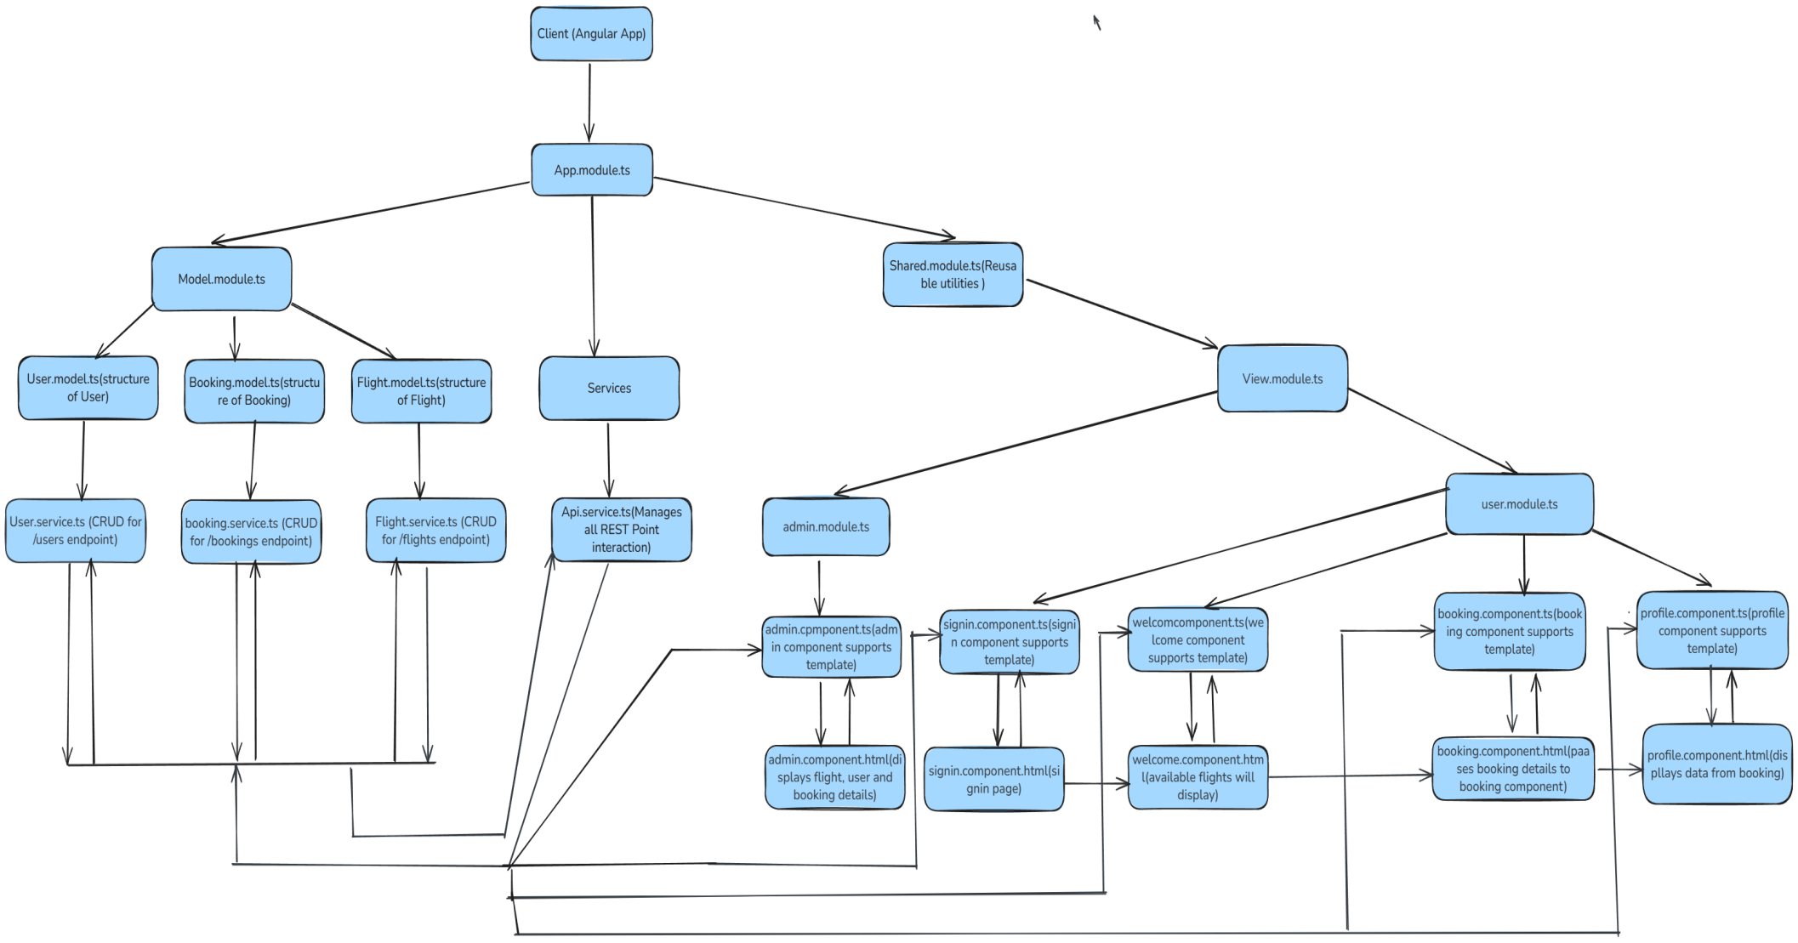
Architecture Diagram

Slide 6
Live Demonstration
Now let’s see the Flight Management System in action!

